Slide 1

Automated Generation of Modular and Dynamic Industrial Process Plant Visualizations
Bachelor Thesis
Miguel Romero Karam
Notes:
Hello Everybody, my name is…
And in this short presentation
I’ll give an overview of my work at Gefasoft and my bachelor thesis with the topic of:

Slide 2
Introduction Motivation
Why?
Notes:
Why? What is the motivation behind this project? …

Slide 3
Introduction Motivation
Frequent technical changes
Notes:
Well, current trends in automation technology lead to frequent technical changes in process facilities of all kinds…

Slide 4
Introduction Motivation
Frequent technical changes → constant increase in complexity of industrial facilities
Notes:
This changes then lead to a constant increase in the complexity of industrial facilities...

Slide 5
Introduction Motivation
Frequent technical changes → constant increase in complexity of industrial facilities
Changes propagate throughout
Documentation
Maintenance
Operation
Notes:
Additionally, the changes propagate through documentation, maintenance and operation…

Slide 6
Introduction Motivation
Frequent technical changes → constant increase in complexity of industrial facilities
Changes propagate throughout → major engineering challenge
Documentation
Maintenance
Operation
Notes:
All of which represents a major engineering challenge…

Slide 7
Introduction Motivation
Frequent technical changes → constant increase in complexity of industrial facilities
Changes propagate throughout → major engineering challenge
Documentation
Maintenance
Operation
Due to this reasons, the development and modification of visualizations for process engineering plants requires a very high technical effort
Notes:
Due to this reasons, the development and modification of visualizations for process engineering plants requires a very high technical effort

Slide 8
Introduction Problem Definition
What?
Notes:
Driven by this motivation, what is to be done? …

Slide 9
Introduction Problem Definition
Required:
Notes:
Well, in order to solve these issues …

Slide 10
Introduction Problem Definition
Required: A solution to automate the generation of modular and dynamic plant Piping and Instrumentation Diagram (P&ID) visualizations
Notes:
a solution to automate the generation of modular and dynamic plant Piping and Instrumentation Diagram (P&ID) visualizations
is required

Slide 11
Introduction Problem Definition
Required: A solution to automate the generation of modular and dynamic plant Piping and Instrumentation Diagram (P&ID) visualizations
with minimal user configuration and
Notes:
This solution should required minimal user configuration and…

Slide 12
Introduction Problem Definition
Required: A solution to automate the generation of modular and dynamic plant Piping and Instrumentation Diagram (P&ID) visualizations
with minimal user configuration and
integration to the MES software at hand.
Notes:
Be integrated to the MES software at hand, namely the Legato Web Application

Slide 13
Introduction Goals
How?
Notes:
And how is this to be done?
Well, the project was lead by 3 major goals. These are:

Slide 14
Introduction Goals
Reduce technical effort and accelerate creation of Piping and Instrumentation Diagram (P&ID) visualizations
Notes:
First off, to reduce technical effort and accelerate creation of Piping and Instrumentation Diagram (P&ID) visualizations

Slide 15
Introduction Goals
Reduce technical effort and accelerate creation of Piping and Instrumentation Diagram (P&ID) visualizations
Create a library of all standardized P&ID symbols
Notes:
Second, to create a library of standardized P&ID symbols for all available Process Engineering Elements.

Slide 16
Introduction Goals
Reduce technical effort and accelerate creation of Piping and Instrumentation Diagram (P&ID) visualizations
Create a library of all standardized P&ID symbols
Prototypal Implementation in a Manufacturing Execution System (MES)
Notes:
And last but not least, to implement the system prototypically in the Manufacturing Execution System at hand:
The Legato Web Application

Slide 17
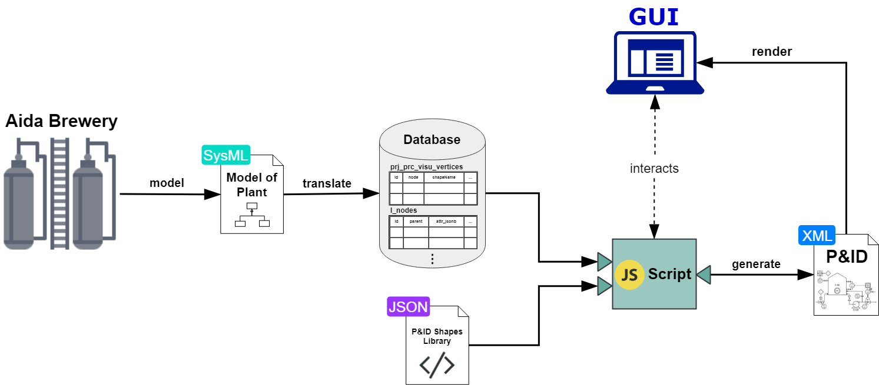
Conceptual Overview Scope of the Project
Notes:
I’ll start off by showing the overview of the project.
NEXT

Slide 18
Conceptual Overview Scope of the Project
Notes:
To start, we have the example facility used for this project, the Aida Brewery

Slide 19
Conceptual Overview Scope of the Project
Notes:
Before the start of this project, this facility had already been modelled with SysML, a modelling language used in the field of automation.

Slide 20
Conceptual Overview Scope of the Project
Notes:
This SysML model could already be translated into relational database tables
This means, that the plant instance hierarchy was now available as flat tables for this project to consume.

Slide 21
Conceptual Overview Scope of the Project
ProcAppCom
z
Notes:
And this was the context at the start of this project.
My project thus continues works done by others within the bigger ProcAppCom project.
The ProcAppCom project:
-is a current research project
-carried out by the Techncial University of Munich, Gefasoft and other industry partners
-deals with the automatic configuration and generation of control codes and visualizations for production plants in process engineering
NEXT

Slide 22
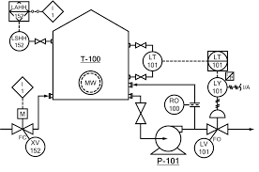
Conceptual Overview Scope of the Project
ProcAppCom
z
Notes:
This project deals with the automated generation of Piping and Instrumentation Diagram visualizations like the one shown on the right.
NEXT

Slide 23
Conceptual Overview Scope of the Project
ProcAppCom
z
Notes:
So first off, there has to be a library of P&ID shapes …

Slide 24
Conceptual Overview Scope of the Project
ProcAppCom
z
Notes:
A Client-side script should then take-in the plant data from the database and the shapes library …

Slide 25
Conceptual Overview Scope of the Project
ProcAppCom
z
Notes:
To generate the P&ID visualization in XML format

Slide 26
Conceptual Overview Scope of the Project
ProcAppCom
z
Notes:
This P&ID visualization is then to be rendered directly in a Graphical User Interface in the browser…

Slide 27
Conceptual Overview Scope of the Project
ProcAppCom
z
Notes:
And through this Graphical User Interface is that the user is able to create these visualizations.

Slide 28
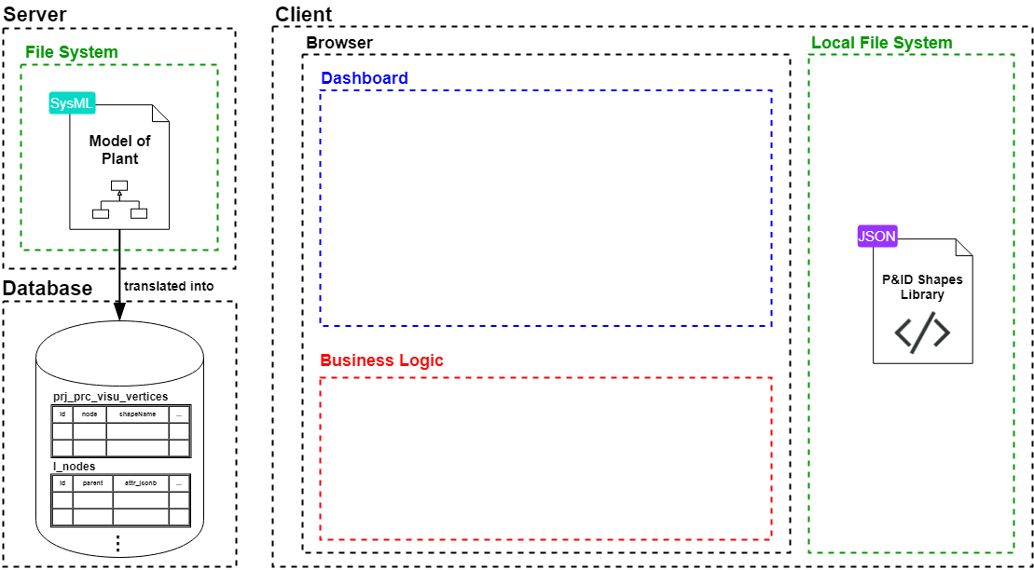
Software Architechture Initial Situation
Notes:
So, before diving deeper, here you can see the initial situation at the start of my bachelor thesis.
As you can see, the Model of the Plant and its translation to the database was already present on the back-end
The development of this project was therefore to be entirely on the client-side …

Slide 29
Software Architechture Scope of this Project
Notes:
… (or this area in yellow)
The developed solution consits of 3 Major parts:
P&ID shapes library
Front-end GUI in form of a Legato Dashboard
The business logic for the generation of the P&ID in XML format

Slide 30
Software Architechture P&ID Shapes Library
Notes:
First off was the
-development of the P&ID shapes library
-in form of a single JSON file with the static definition of all shapes
-to be saved in the user’s local file system

Slide 31

Software Architechture P&ID Shapes Library
Notes:
Additionaly to the static JSON file of the library, an Excel file for easier customization.
Nevertheless, library is done and does not require any more configurations.

Slide 32
Software Architechture P&ID Shapes Library
?
Notes:
Well, and how was the shapes library created?

Slide 33
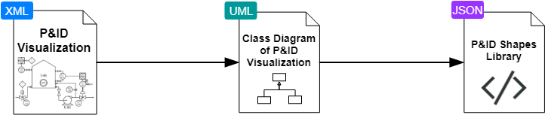
P&ID Shapes Library Objected-oriented Abstraction of Shapes
Notes:
Well, for that, an object-oriented abstraction of the shape geometries was made
This process had 3 main steps…

Slide 34
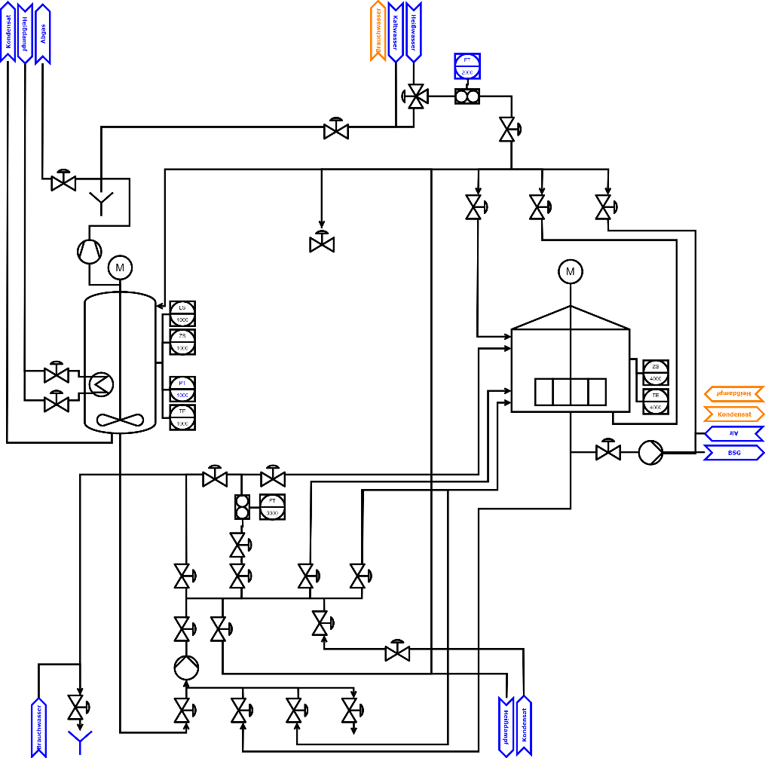
P&ID Shapes Library Objected-oriented Abstraction of Shapes
P&ID of Aida Brewery
Notes:
First, a P&ID of the Aida Brewery was
-manually drawn with the development tools to be used
-and aligning to the requirements set at the start of the project for the final P&ID (for example, it was decided what contents the P&ID should at least include)

Slide 35
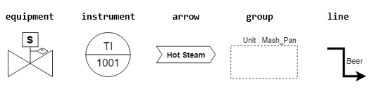
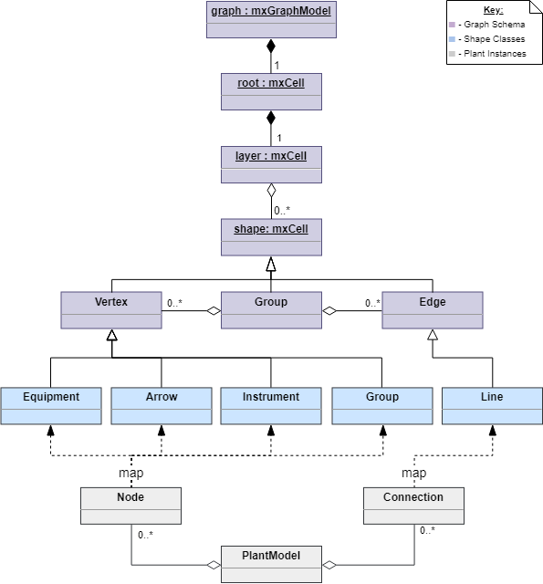
P&ID Shapes Library Objected-oriented Abstraction of Shapes
Class Diagram of P&ID
Notes:
Second was the object-oriented abstraction of the shapes into 5 elementary Classes. For this, the P&ID was
1) exported in XML format
2) analysed and compared to the mxGraph API documentation
3) structured into a UML class diagram of the Underlying Schema

Slide 36
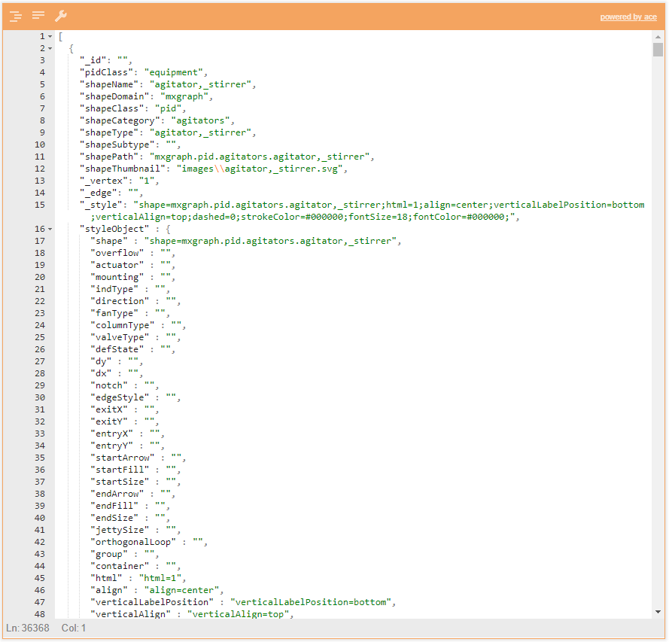
P&ID Shapes Library Objected-oriented Abstraction of Shapes
P&ID Shapes Library (474)
Notes:
Finally,
-a flat JSON file was created following this schema definition
-for all Process Engineering Symbols of the Draw.io standard library (474 shapes in total)
-JSON file contains the static definition of all shape geometries according to industry standards
So needless to say, the library is done and does not require any more configurations.

Slide 37
Software Architechture P&ID Shapes Library
Notes:
Back to the software arhitechture,
Next in development was the front-end part …

Slide 38
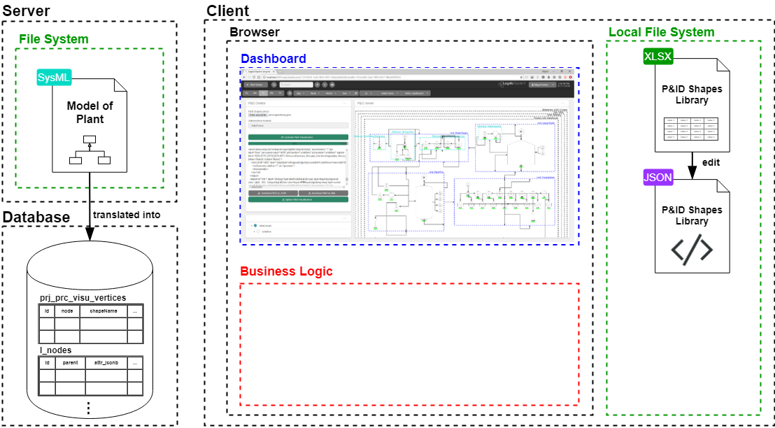
Software Architechture Graphical User Interface
Notes:
Or the Graphical User Interface

Slide 39
Software Architechture Graphical User Interface
?
Notes:
How does this Graphcial user interface look like? …

Slide 40
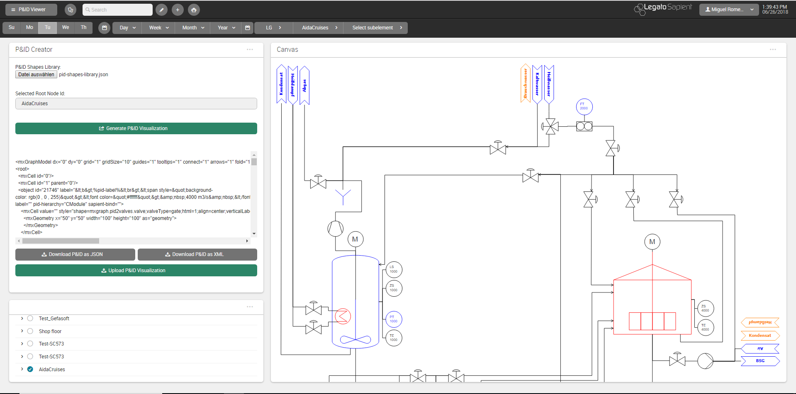

GUI P&ID Viewer Dashboard
Notes:
-The GUI takes the form a of Legato Dashboard within the Legato Web Application
-The Dashboard consists of 2 Legato Boardlets …

Slide 41
GUI P&ID Viewer Dashboard
Legato Graphic Designer
Boardlet
Notes:
1) Legato Graphic Designer boardlet (for the rendering of the P&ID)

Slide 42
GUI P&ID Viewer Dashboard
Node Tree Boardlet
Notes:
2) And the Node Tree Menu boardlet (for the selection of the desired root node for the visualization)

Slide 43
GUI P&ID Viewer Dashboard
P&ID Creator Boardlet
Notes:
Plus the newly developed P&ID Creator Boardlet which encapsulates everything for the generation of P&ID visualizations
-We’ll take a closer look on this boardlet alone …

Slide 44
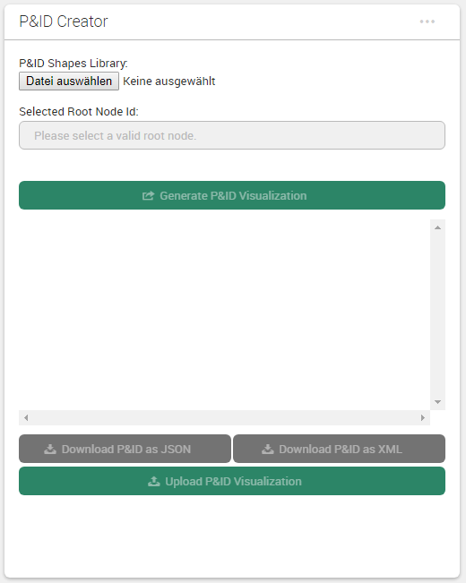
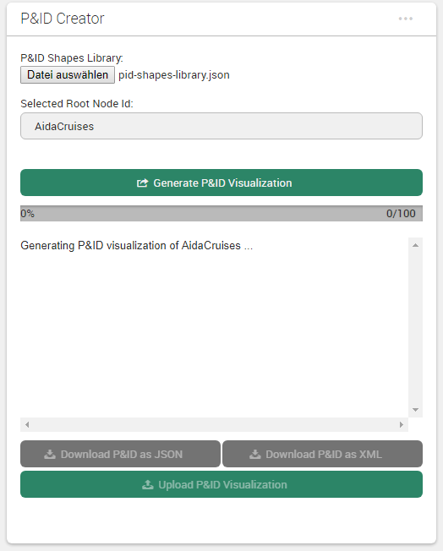
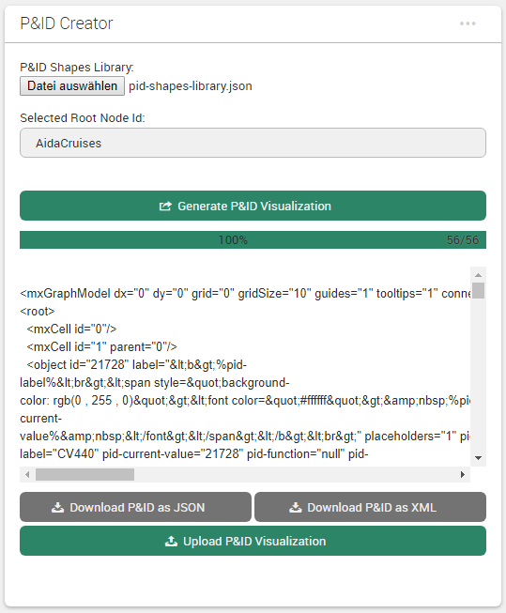
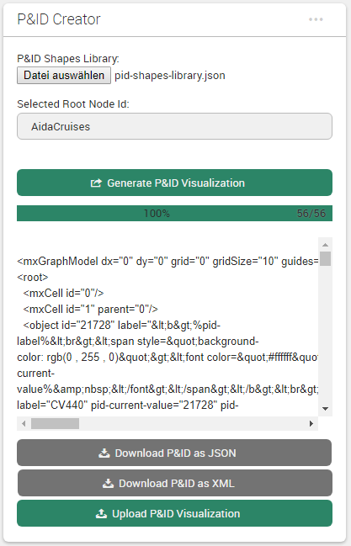
GUI P&ID Creator Boardlet
1. On start
2. In progress
3. Done
desktop
mobile
Notes:
1) On start, there are only 3 straight-forward steps required from the user:
- Selection of the shapes library file
- Selection of the root node of what is to be visualized (with the node tree boardlet)
- And clicking the “Generate P&ID Visualization” button to start the background generation of the P&ID
2) Afterwards, a progress bar is displayed during the generation of the P&ID (with the total number of nodes of the selected root node hierarchy)
3) When done, the P&ID XML will be rendered for easy copy-pasting to draw.io for example
Note the responsive design of the boardlet

Slide 45
Software Architechture Graphical User Interface
Notes:
Back to the software arhitechture,
Third was the development of…

Slide 46
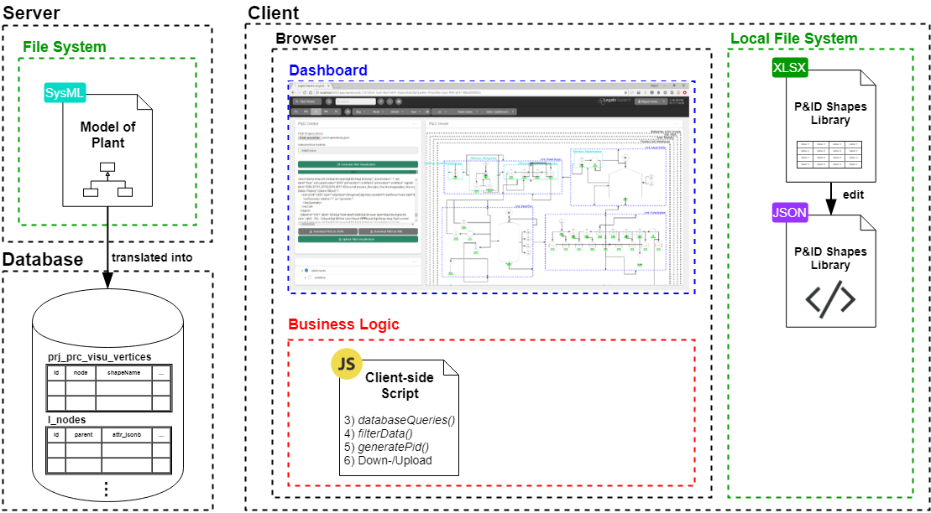
Software Architechture Business Logic
Notes:
the busness logic for the generation of the P&ID visualizations …

Slide 47
Software Architechture Business Logic
?
Notes:
The entire business logic runs on the client-side, directly in the browser,
but how exactly was it structured?

Slide 48
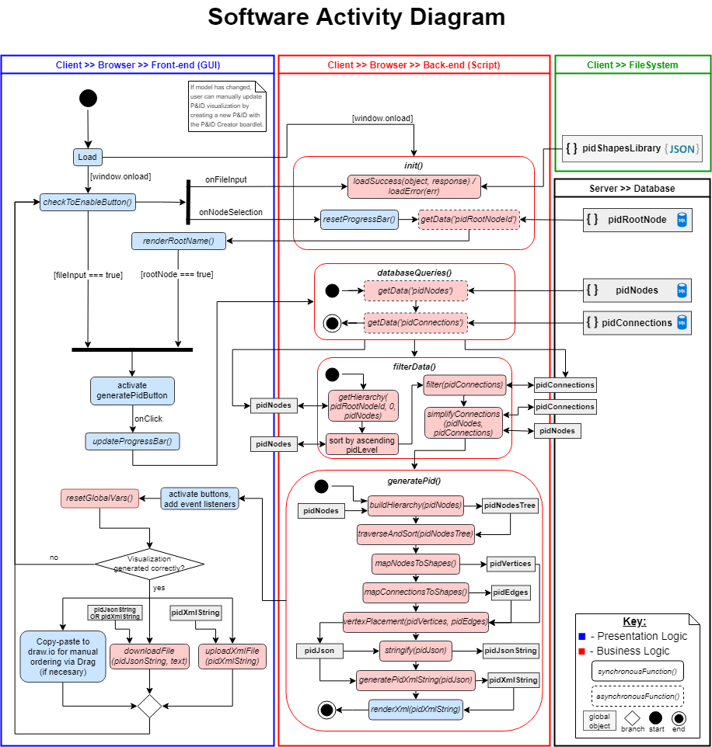
Script Activity Diagram
Notes:
Don’t be overwhelmed,
This activity diagram encompasses all logic of the system, both:
-presentation logic (shown in blue) and
-business logic (shown in red and responsable for the generation of the P&ID)
For the sake of clarity though, I will focus only on the main functionalities of the business logic
I’ll start off with the data …

Slide 49
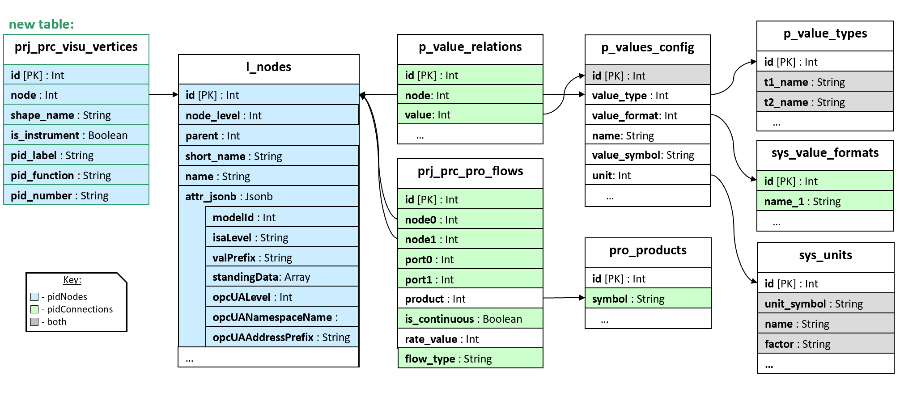
Fetching Data Global Data Map
Notes:
Here you can see the data map of all required database atributes for the P&ID generation
-All data is queried via SQL JOINs according to this schema
-Only a single table had to be added to the database (Visu_vertices)
BUT HOW WAS ALL THIS DATA TO BE CONVERTED INTO A VISUALIZATION?

Slide 50
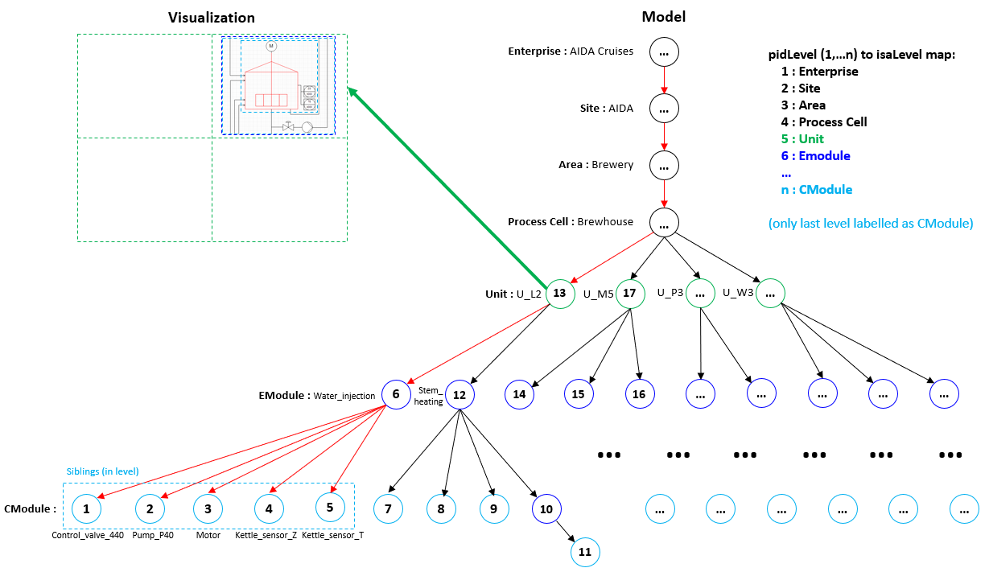
Graphing Algorithm Concept: From Node Tree to Visualization
Notes:
Well, the instance hierarchy is already that, a hierarchy, as you can see from the tree in the right of the Aida Cruises Enterprise
Using this to our advantage, the graphing algorithm traverses this hierarchy POST-ORDER, and DEPTH-FIRST in order to get the positioning order of the nodes.
For example, the algorithm would traverse this plant hierarchy as follows … starting from the selected root node …
So we know have the placement order of the nodes, but how exactly are they to be positioned, well …

Slide 51
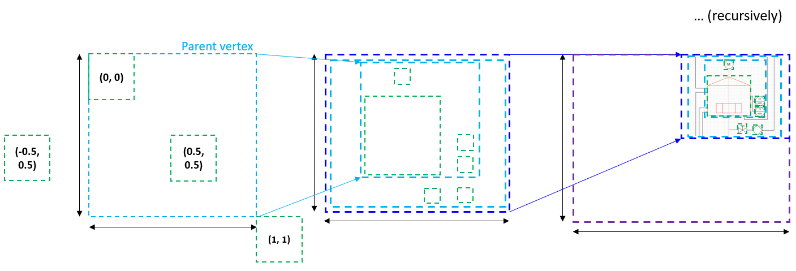
Graphing Algorithm Concept: Relative Positioning
Notes:
By relative positioning. So the algorithm basically takes the nodes in the previously calculated order and places them, one-by-one, relative to THE CORNER OR ORIGIN of their parent node.
BUT THE ACTUAL POSITIONING LOGIC OF A P&ID IS MUCH MORE COMPLEX THAN THAT …

Slide 52
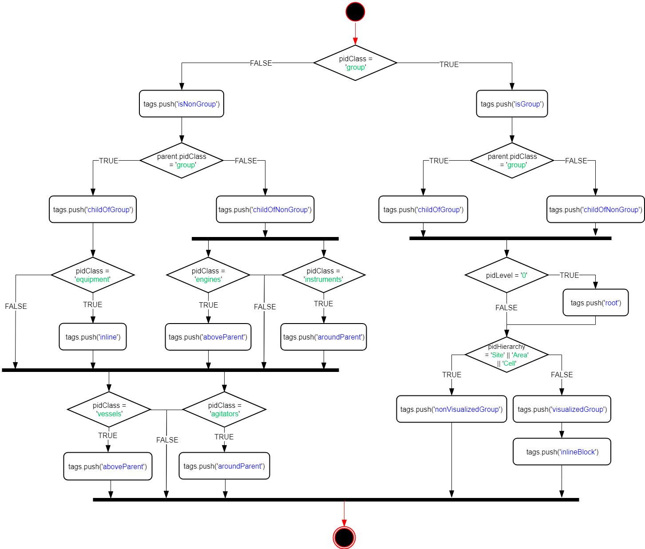
Graphing Algorithm 1. Specification of Constraints
Notes:
FOR THIS REASON: all shapes are iterated through this conditional logic, modelled by the activity diagram shown.
What this does is it tags each shape based on its inherent characteristics.
After that, for the actual positioning of the shapes…

Slide 53
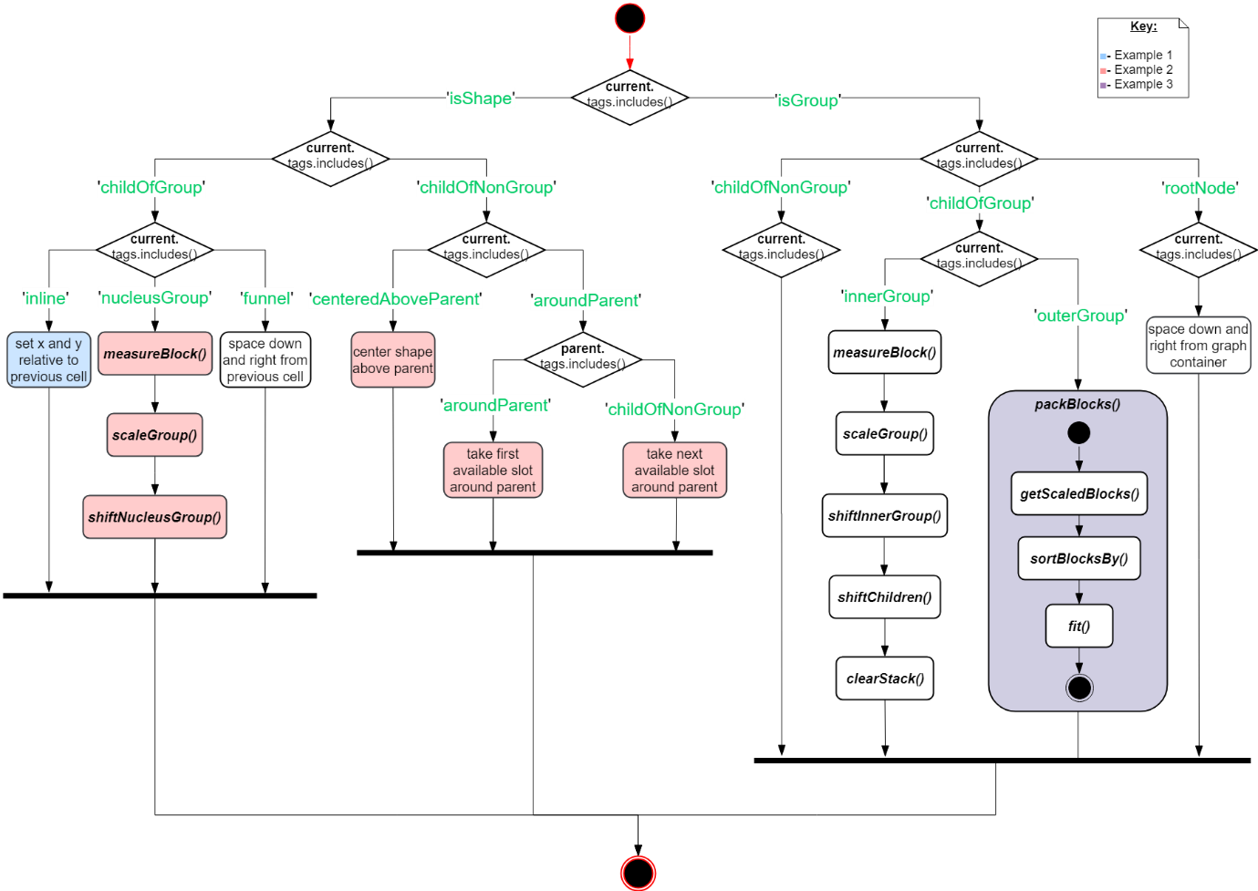
Graphing Algorithm 2. Vertex Placement
Notes:
There is a much more complex positioning logic, modelled here by this activity diagram
For the sake of brevity, 3 example positioning cases will be presented in the next slides to describe some of this positioning logic

Slide 54
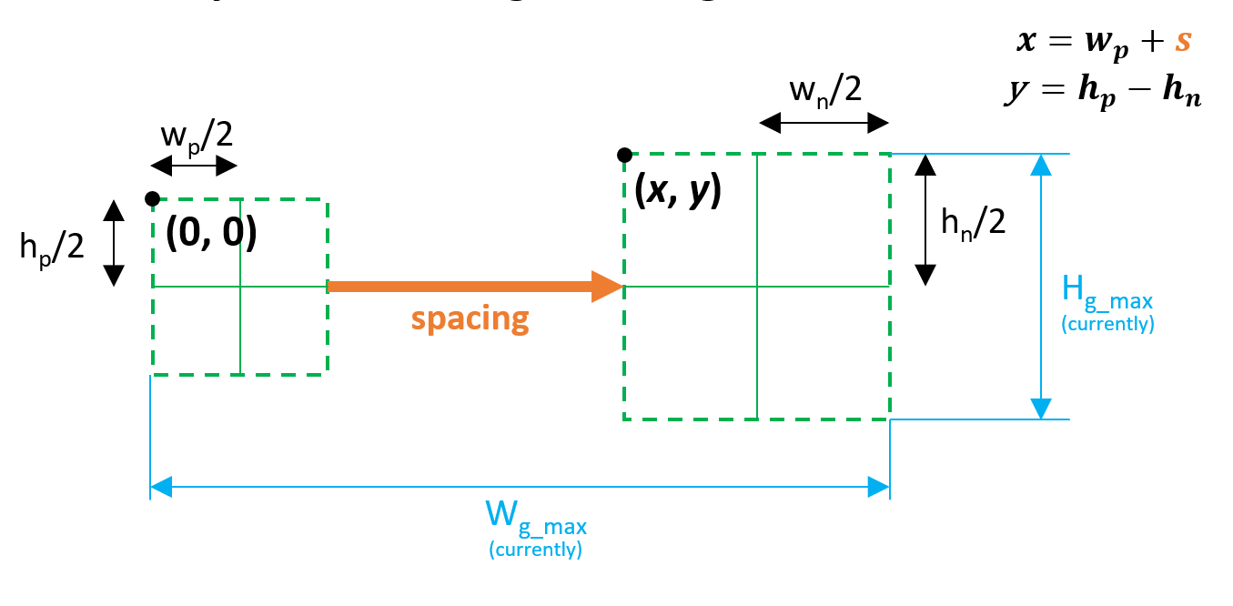
Example 1 Consecutive Inline Shapes
#inline
Notes:
The first example is the positioning of shapes tagged with an INLINE tag

Slide 55
Example 1 Consecutive Inline Shapes
#inline
Horizontal offset from previous by spacing (global variable)
Notes:
This shapes are horizontally ofsset to their previous shape by a magnitude of the spacing global variable

Slide 56
Example 1 Consecutive Inline Shapes
#inline
Horizontal offset from previous by spacing (global variable)
Vertically centered
Notes:
Then, they are vertically centered with respect to its previous shape

Slide 57
Example 1 Consecutive Inline Shapes
#inline
Horizontal offset from previous by spacing (global variable)
Vertically centered
Notes:
This image shows the geometries used for this calculation, as ALL POSITIONING IS DONE by setting the X and Y properties of each shape (relative to the origin of its parent)

Slide 58
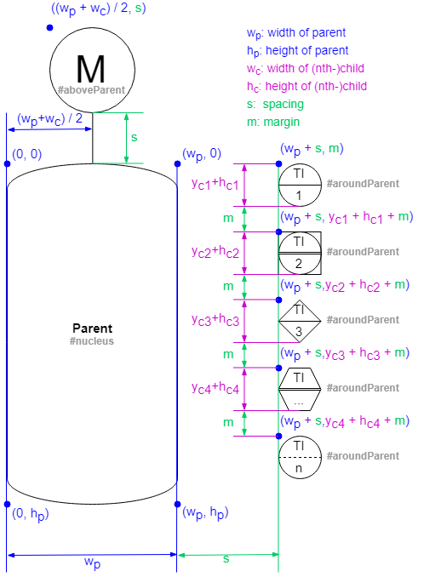
Example 2 Nucleus Shape and its Children
#nucleus
Notes:
A second, more complex example is that of NUCLEUS shapes like a vessel or tank …

Slide 59
Example 2 Nucleus Shape and its Children
#nucleus
Placed in center
Notes:
NucleusShapes

Slide 60
Example 2 Nucleus Shape and its Children
#nucleus
Placed in center
Children relatively placed
based on tags:

Slide 61
Example 2 Nucleus Shape and its Children
#nucleus
Placed in center
Children relatively placed
based on tags:
#aboveParent

Slide 62
Example 2 Nucleus Shape and its Children
#nucleus
Placed in center
Children relatively placed
based on tags:
#aboveParent
#aroundParent

Slide 63
Example 2 Nucleus Shape and its Children
#nucleus
Placed in center
Children relatively placed
based on tags:
#aboveParent
#aroundParent
#aroundParent

Slide 64
Example 2 Nucleus Shape and its Children
#nucleus
Placed in center
Children relatively placed
based on tags:
#aboveParent
#aroundParent
#aroundParent
#aroundParent

Slide 65
Example 2 Nucleus Shape and its Children
#nucleus
Placed in center
Children relatively placed
based on tags:
#aboveParent
#aroundParent
#aroundParent
#aroundParent
#aroundParent

Slide 66
Example 2 Nucleus Shape and its Children
#nucleus
Placed in center
Children relatively placed
based on tags:
#aboveParent
#aroundParent
#aroundParent
#aroundParent
#aroundParent
#aroundParent

Slide 67
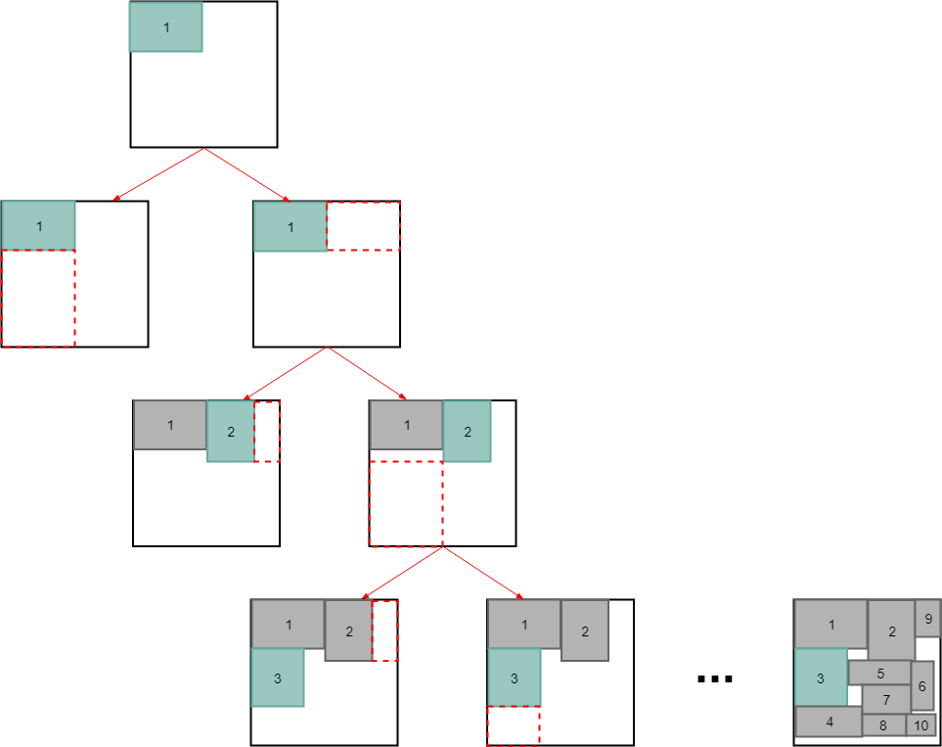
Example 3 Outer Groups with only Group Children
#OuterGroup:
Notes:
The third positioning example is for OuterGroups …

Slide 68
Example 3 Outer Groups with only Group Children
#OuterGroup:
Groups which contain only groups and no shapes
Notes:
OuterGroups are groups which contain only groups and no shapes as children

Slide 69
Example 3 Outer Groups with only Group Children
#OuterGroup:
Groups which contain only groups and no shapes
Placed with Block Packing Algorithm

Slide 70
Example 3 Outer Groups with only Group Children
#OuterGroup:
Groups which contain only groups and no shapes
Placed with Block Packing Algorithm
→ Minimize Area

Slide 71
Example 3 Outer Groups with only Group Children
First group placed within #outerGroup

Slide 72
Example 3 Outer Groups with only Group Children
below?
right?

Slide 73
Example 3 Outer Groups with only Group Children
right

Slide 74
Example 3 Outer Groups with only Group Children
right?
below?

Slide 75
Example 3 Outer Groups with only Group Children
below

Slide 76
Example 3 Outer Groups with only Group Children

Slide 77
Example 3 Outer Groups with only Group Children

Slide 78
Example 3 Outer Groups with only Group Children
Until all groups placed in minimum total area

Slide 79
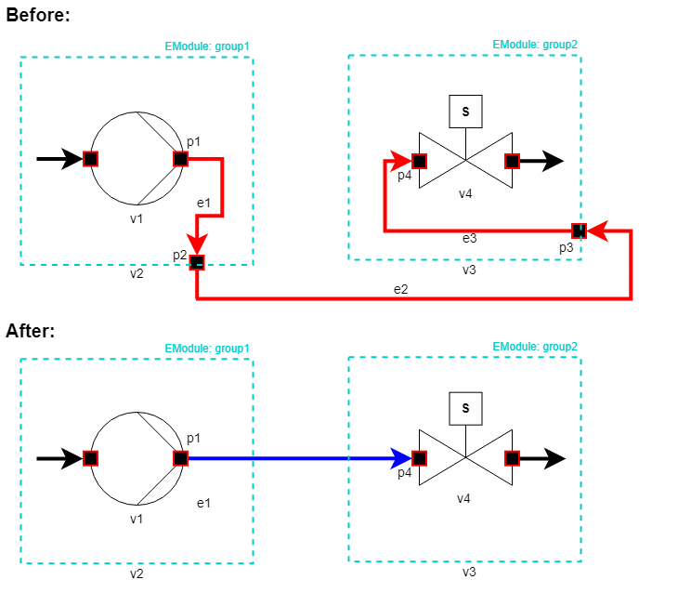
Graphing Algorithm Simplification of Connections
Notes:
Additionally, the drawing of the connections presented several other challenges…
To compensate for how the connections are modelled in the database (shown here in red), an algorithm had to be developed to straighten out the edges, or clear the waypoints between real source and target shapes.

Slide 80
Graphing Algorithm Simplification of Connections
Notes:
In blue you see the output of the algorithm, and how this handles this issue …
Its much more visually appealing, and results in easier to understand visualizations.

Slide 81
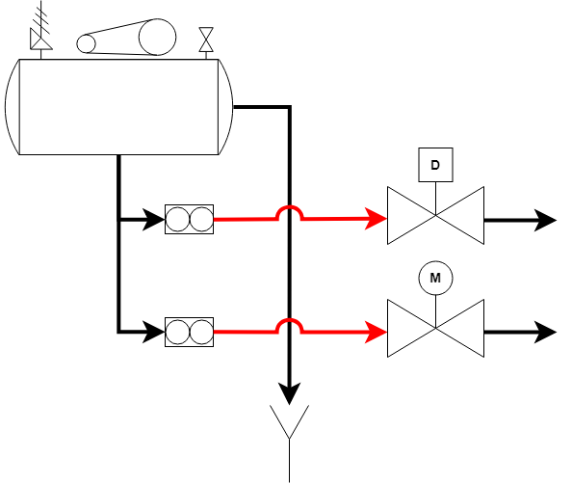
Graphing Algorithm Applying Line Jumps
Notes:
Similarly the algorithm had to apply line jumps for the sake of clarity of the final P&ID, due to the high number of lines

Slide 82

Software Architechture Overview
Notes:
So, once again back to the software architechture.
This time around I’m going to show you how this all connects.

Slide 83
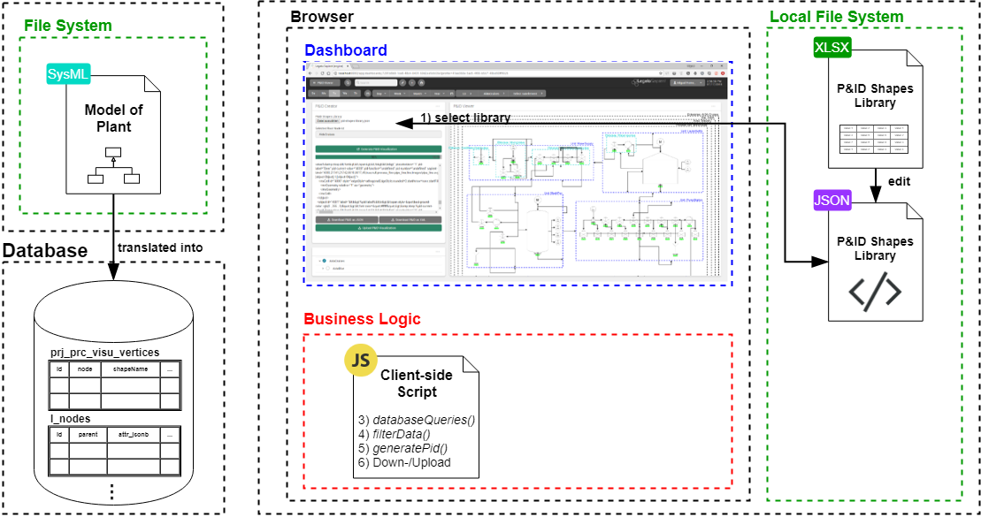
Software Architechture Overview

Slide 84

Software Architechture Overview

Slide 85
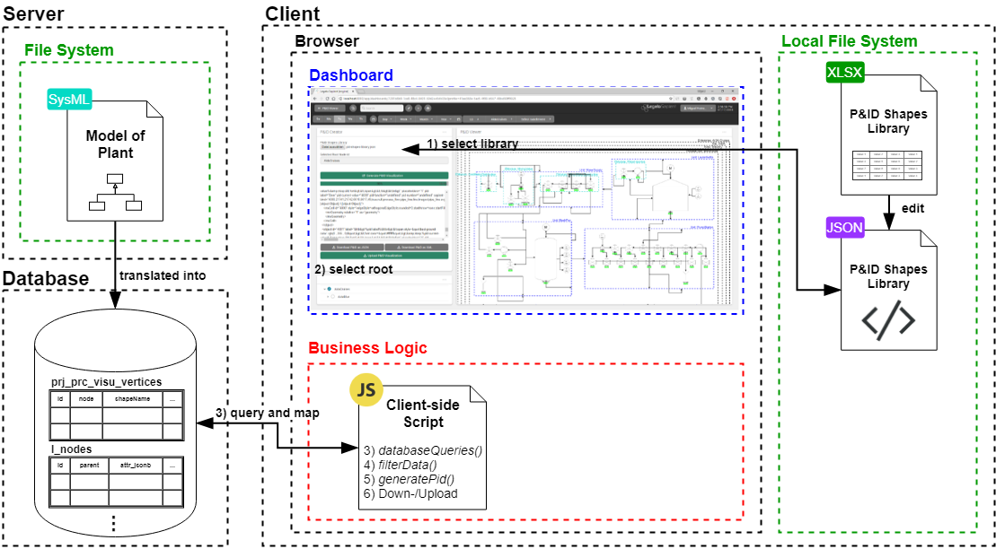
Software Architechture Overview

Slide 86
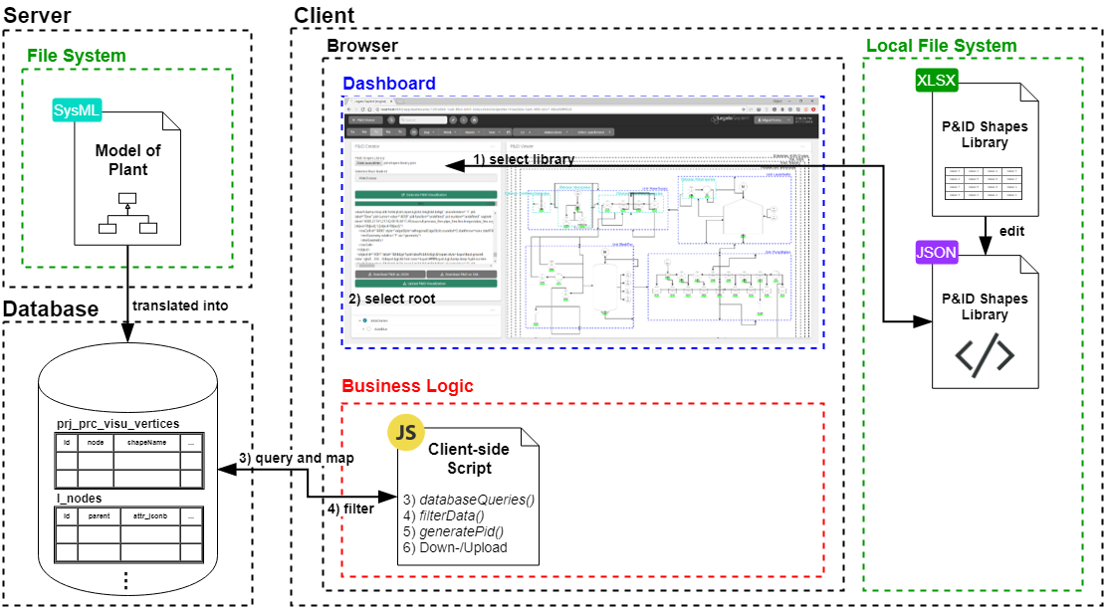
Software Architechture Overview

Slide 87
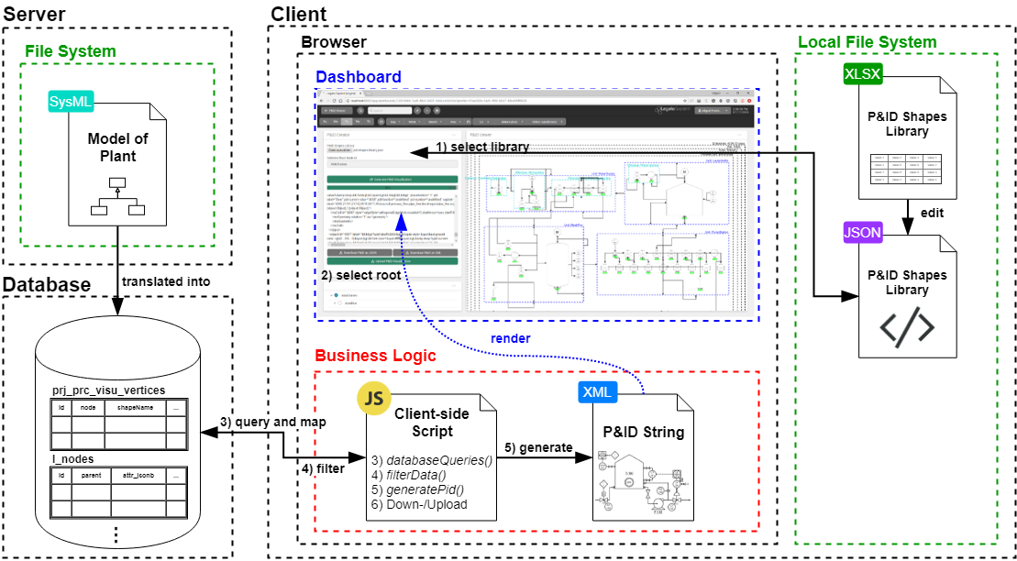
Software Architechture Overview

Slide 88
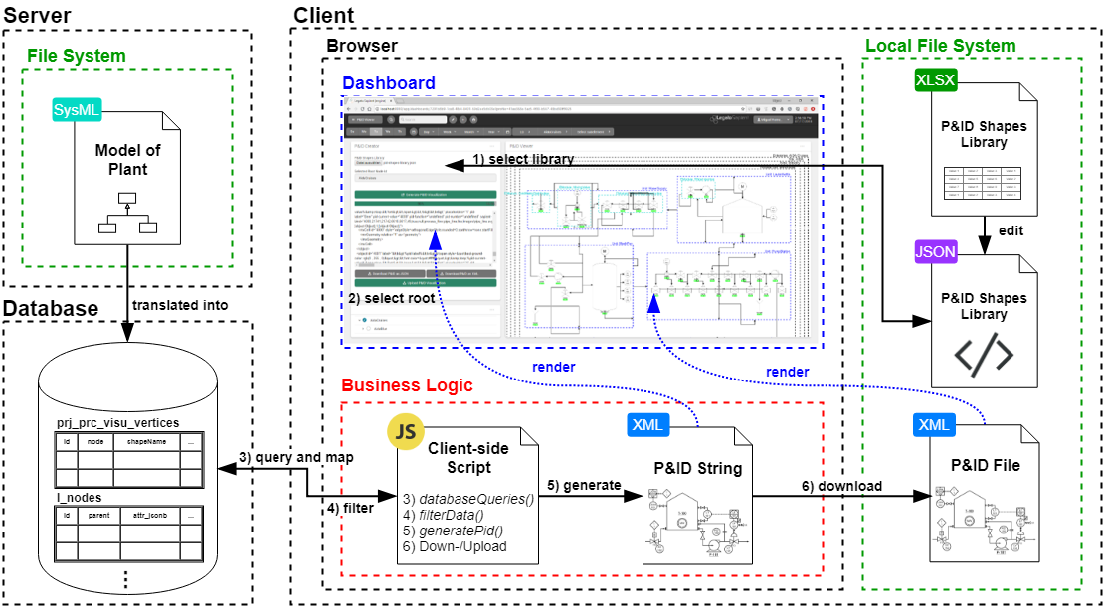
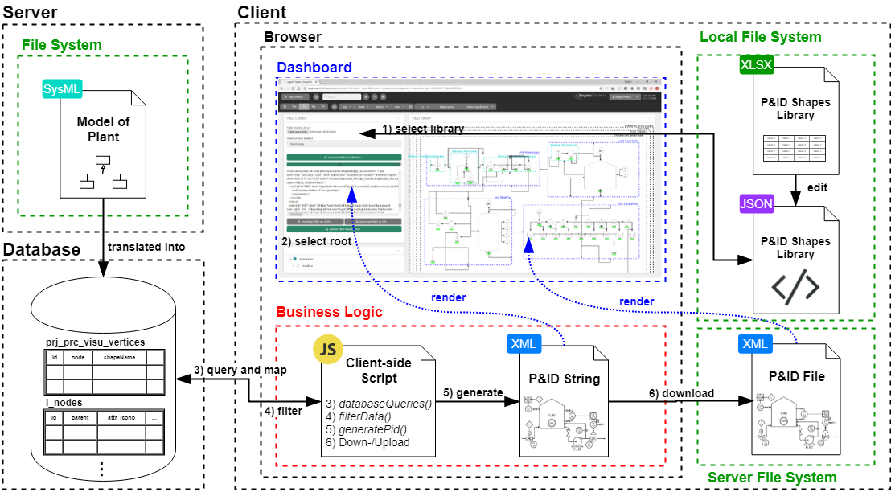
Software Architechture Overview

Slide 89
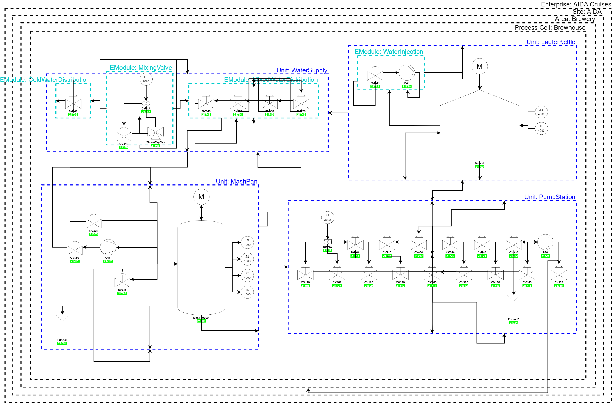
Result P&ID of Aida Brewery
Notes:
So, how does the resulting P&ID of the graphing algorithm look like…
Still much room for improvement
You might notice some connections appear to be missing, well, they are in fact present and correctly instantiated.
ALGORITHM IS OPTIMIZED TO MINIMIZE LINE CROSSINGS, AS A RESULT, SOMETIMES MULTIPLE LINES ARE COLLAPSED INTO A SINGLE ONE
What I haven’t yet mentioned, is that despite this being a static XML file, it contains data-bindings to the database for real-time, dynamic display of process variables
This dynamic data-bindings are implemented as dynamic Labels, for strings, and fillColors, for Booleans
These are prototypically with the sapient-bind property.
but if we ZOOM IN some parts are trully positioned correctly…
NEVERTHELESS, there exists the POSSIBILITY OF MANUALLY EDITING

Slide 90
Conclusion Bachelor Thesis
Notes:
So, In conclusion …

Slide 91
Conclusion Bachelor Thesis
Much room for improvement (especially in Vertex placement)
Notes:
… although there is still much room for improvement, the achieved must not be overseen …

Slide 92
Conclusion Bachelor Thesis
Much room for improvement (especially in Vertex placement)
In terms of the project goals:
P&ID creation is now much easier and faster ✓
A library of standardized P&ID symbols was successfully created ✓
solution prototypically implemented in a MES ✓
Notes:
IN TERMS OF THE GOALS stated at the start, THE PROJECT WAS SUCCESSFUL AND PROVEN TO WORK IN ITS PROTOTYPICAL IMPLEMENTATION.

Slide 93
Conclusion Bachelor Thesis
Much room for improvement (especially in Vertex placement)
In terms of the project goals:
Creation of P&IDs is now much easier and faster ✓
A library of standardized P&ID symbols was successfully created ✓
solution prototypically implemented in a MES ✓
Notes:
1) The creation of P&IDs is now much easier and faster

Slide 94
Conclusion Bachelor Thesis
Much room for improvement (especially in Vertex placement)
In terms of the project goals:
Creation of P&IDs is now much easier and faster ✓
A library of standardized P&ID symbols was successfully created ✓
solution prototypically implemented in a MES ✓
Notes:
2) A library of standardized P&ID symbols was successfully created

Slide 95
Conclusion Bachelor Thesis
Much room for improvement (especially in Vertex placement)
In terms of the project goals:
Creation of P&IDs is now much easier and faster ✓
A library of standardized P&ID symbols was successfully created ✓
Solution prototypically implemented in a MES ✓
Notes:
3) And the solution was prototypically implemented in the Legato Sapient MES

Slide 96
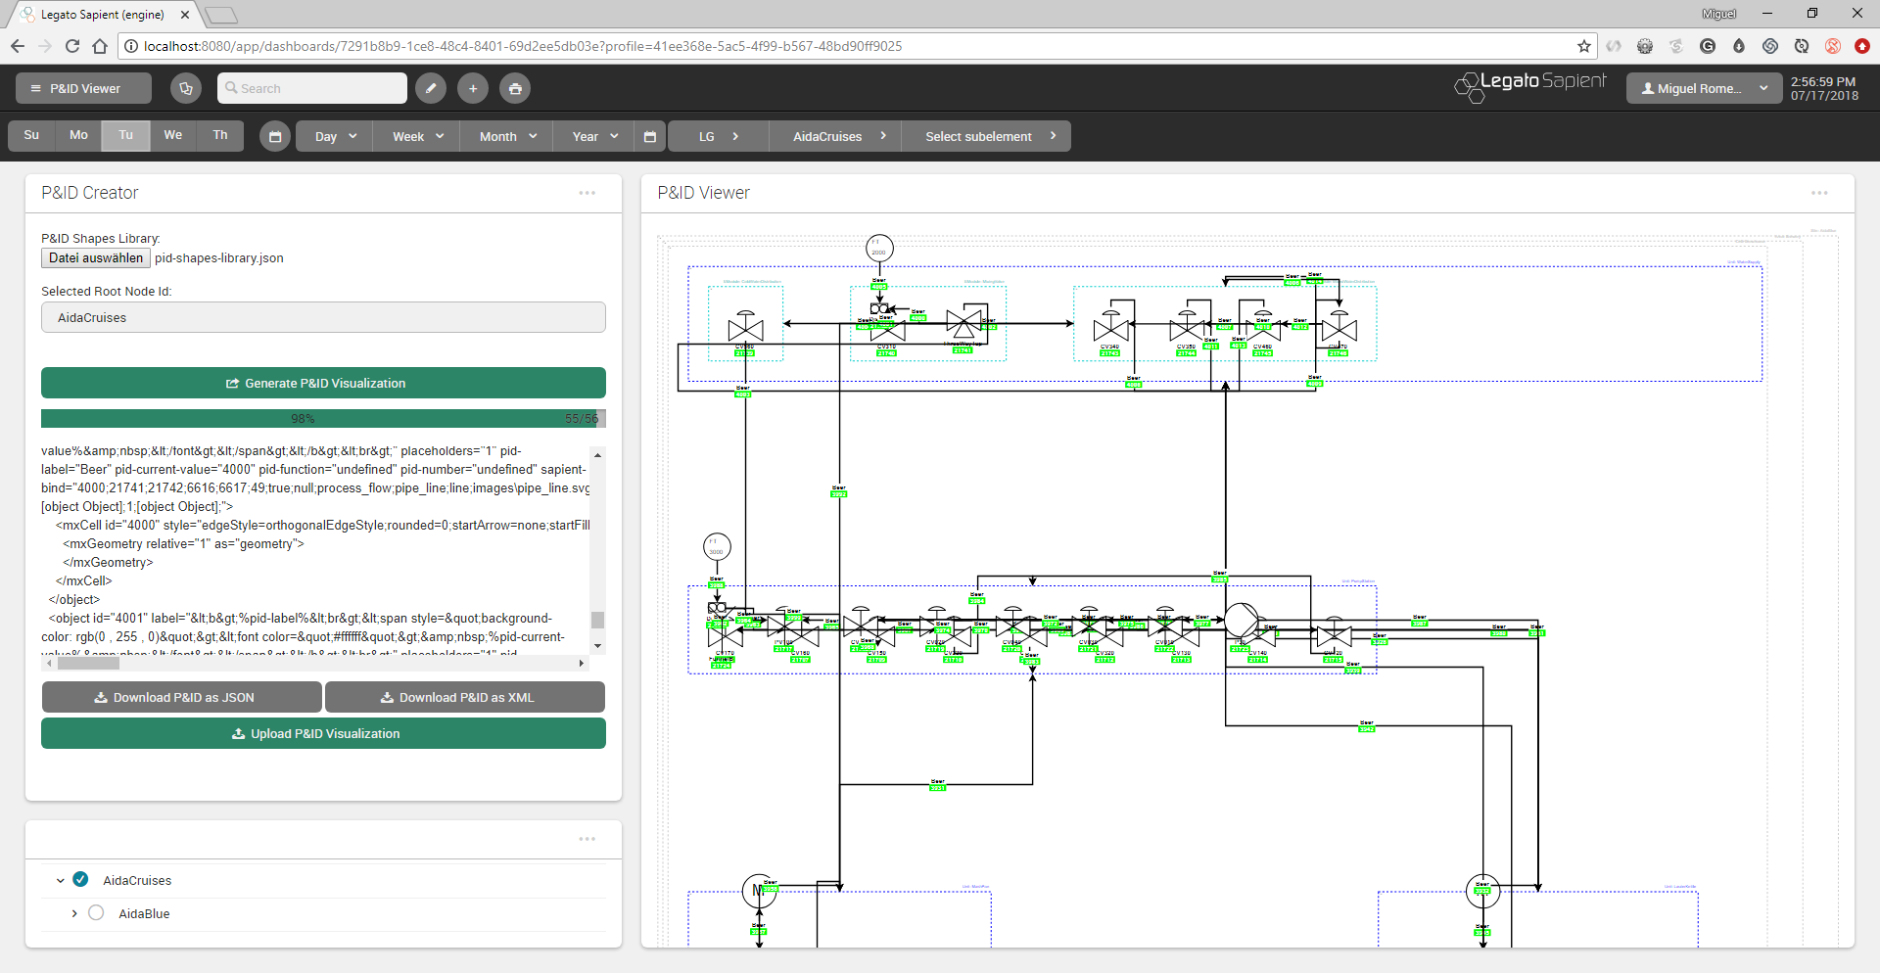
Notes:
IT HAS THEREFORE BEEN PROVEN, that an eventual deployment of AN IMPROVED VERSION OF THIS SOLUTION is INDEED FEASABLE for an industrial context
It is also clear that the automated generation of P&IDs would be of great customer-value
THE QUESTION NOW IS, are this motivations truly worth the development effort for the improvement of this prototype?
NEXT

Slide 97
Automated Generation of Modular and Dynamic Industrial Process Plant Visualizations
Bachelor Thesis
Miguel Romero Karam

Slide 98
Script Activity Diagram
Notes:
Well, this activity diagram encompasses all logic of the system, both:
-presentation logic (shown in blue) and
-business logic (shown in red and responsable for the generation of the P&ID)
For the sake of clarity, I will focus only on the main functionalities of the business logic for the P&ID generation (shown in red).
First off, the data map of the system …

Slide 99
Script Activity Diagram
Notes:
Well, this activity diagram encompasses all logic of the system, both:
-presentation logic (shown in blue) and
-business logic (shown in red and responsable for the generation of the P&ID)
For the sake of clarity, I will focus only on the main functionalities of the business logic for the P&ID generation (shown in red).
First off, the data map of the system …

Slide 100
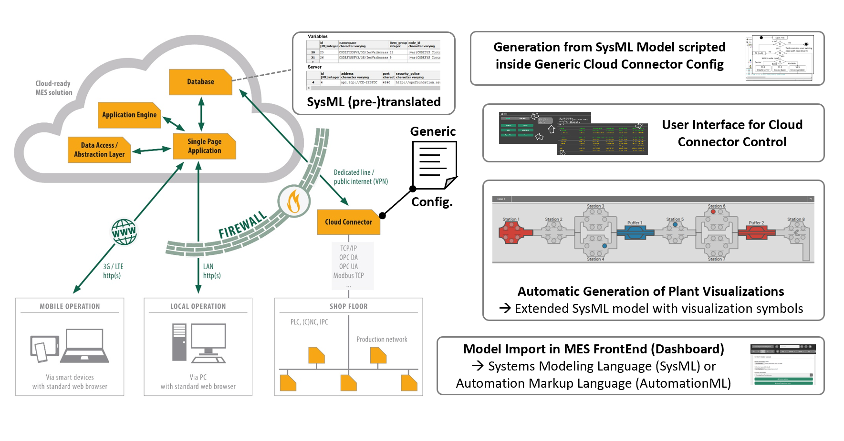
ProcAppCom Project Overview
Copyright: Gefasoft

Slide 101
ProcAppCom Project Overview
Copyright: Gefasoft
Notes:
Project deals with the development of software and visualization for process engineering plants as well as their connection to Manufacturing Execution Systems (MES) currently require a very high effort.
Generic Layout Boardlet (existsts already but only squres and no connections)
Detailed layout boardlet (with draw.io) XML with my boardlet generated

